Slide 1
How to Make Tortillas
Como Hacer/Cocinar las Tortillas

Slide 2
First, learn how to make positive tú commands
To make a positive tú command (which means you want your friend to do something) simply go to the present tense form of the verb and drop down to the 3rd person line.
Don't use a pronoun. Just state the verb.

Slide 3
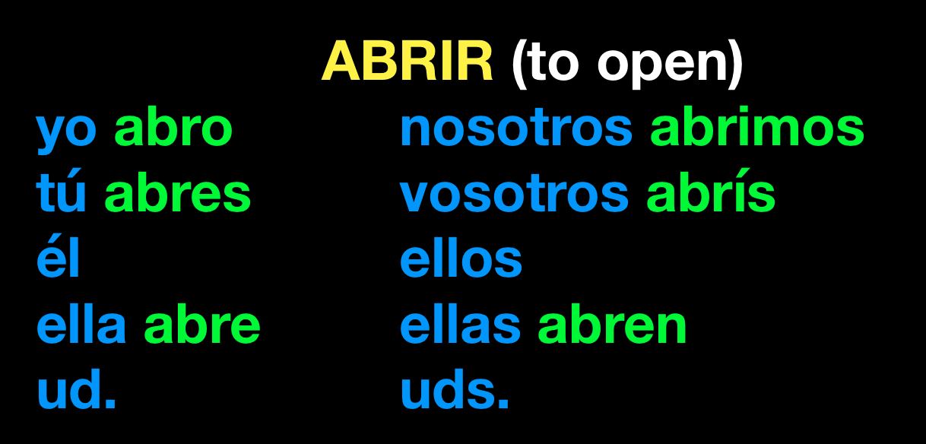
For example:
If you want your fiend to open the door, skip over yo and tú, and drop down to the él, ella, ud. category.
Don't say él, ella, or ud. Just say, --¡Abre la puerta!--

Slide 4
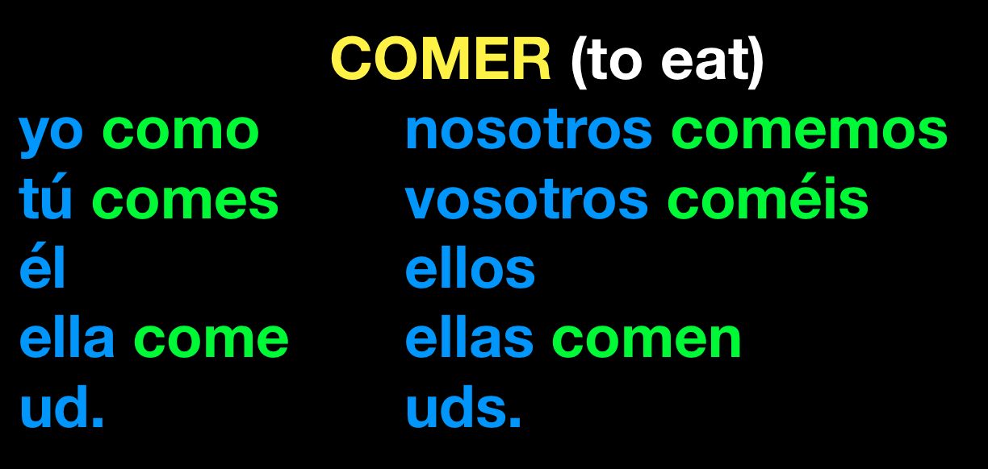
If you want your friend to eat the food, skip over yo and tú, and drop down to the él, ella, ud. category.
Don't say él, ella, or ud. Just say, --¡Come la comida!--

Slide 5
Take a look at your
Quiz Of Life packet
You'll find ABRIR and COMER on the last page of regular ER/IR verbs.
When verbs are regular, positive tú commands are easy.
What about the first page of that packet?

Slide 6
First Page of
Quiz Of Life packet
You'll want to copy these down for future use (like today). Some, not all, are irregular.
SER: sé
IR: ve
DAR: da
ESTAR: está
SABER: sabe

Slide 7
First Page of
Quiz Of Life packet
You'll want to copy these down for future use.
TENER: ten
HACER: haz
PONER: pon
SALIR: sal
VENIR: ven

Slide 8
First Page of
Quiz Of Life packet
You'll want to copy these down for future use.
TRAER: trae
DECIR: di
OÍR: oye
CONOCER: conoce

Slide 9
Now... onto the tortillas
You may not use your phones.
You may use the dictionaries in class.
Tell the sentence to your friend to get him/her to do the action.

Slide 10
Instrucciones
Wash your hands. (Tricky because LAVARSE is reflective. You can use LIMPIAR).

Slide 11
Obtain the ingredientes. (OBTENER works like TENER.)

Slide 12
Boil* the water. (use HERVIR -- careful, e-ie)

Slide 13
Put 4 cups of flour in a bowl large.

Slide 14
Open the salt container.

Slide 15
Put 1 teaspoon of salt to the bowl.

Slide 16
Open the baking powder container.

Slide 17
Put 2 teaspoons of baking soda to the bowl.

Slide 18
Mix the flour, salt, and baking powder with a spoon. (use MEZCLAR)

Slide 19
Have care. Put 1 cup of oil to bowl. Mix well with a spoon.

Slide 20
Use your hands if necessary.

Slide 21
Have care. Put 2 cups of water into bowl. Mix well.

Slide 22
Use your hands if necessary.

Slide 23
When the dough is ready, take out it of bowl.

Slide 24
Cut the dough into pieces. Make balls of dough.

Slide 25
Make flat the balls of dough.

Slide 26
Cook the tortillas at 400 degrees.

Slide 27
Be kind. Give tortillas to your friends.

Slide 28
Eat tortillas.

Slide 29
How did you do?
wash: limpia
obtain: obten
boil: hierve
put: pon
open: abre
mix: mezcla
have: ten
use: usa
take out: saca
cut: corta
cook: cocina
be: sé
give: da
eat: come

